Slide 1
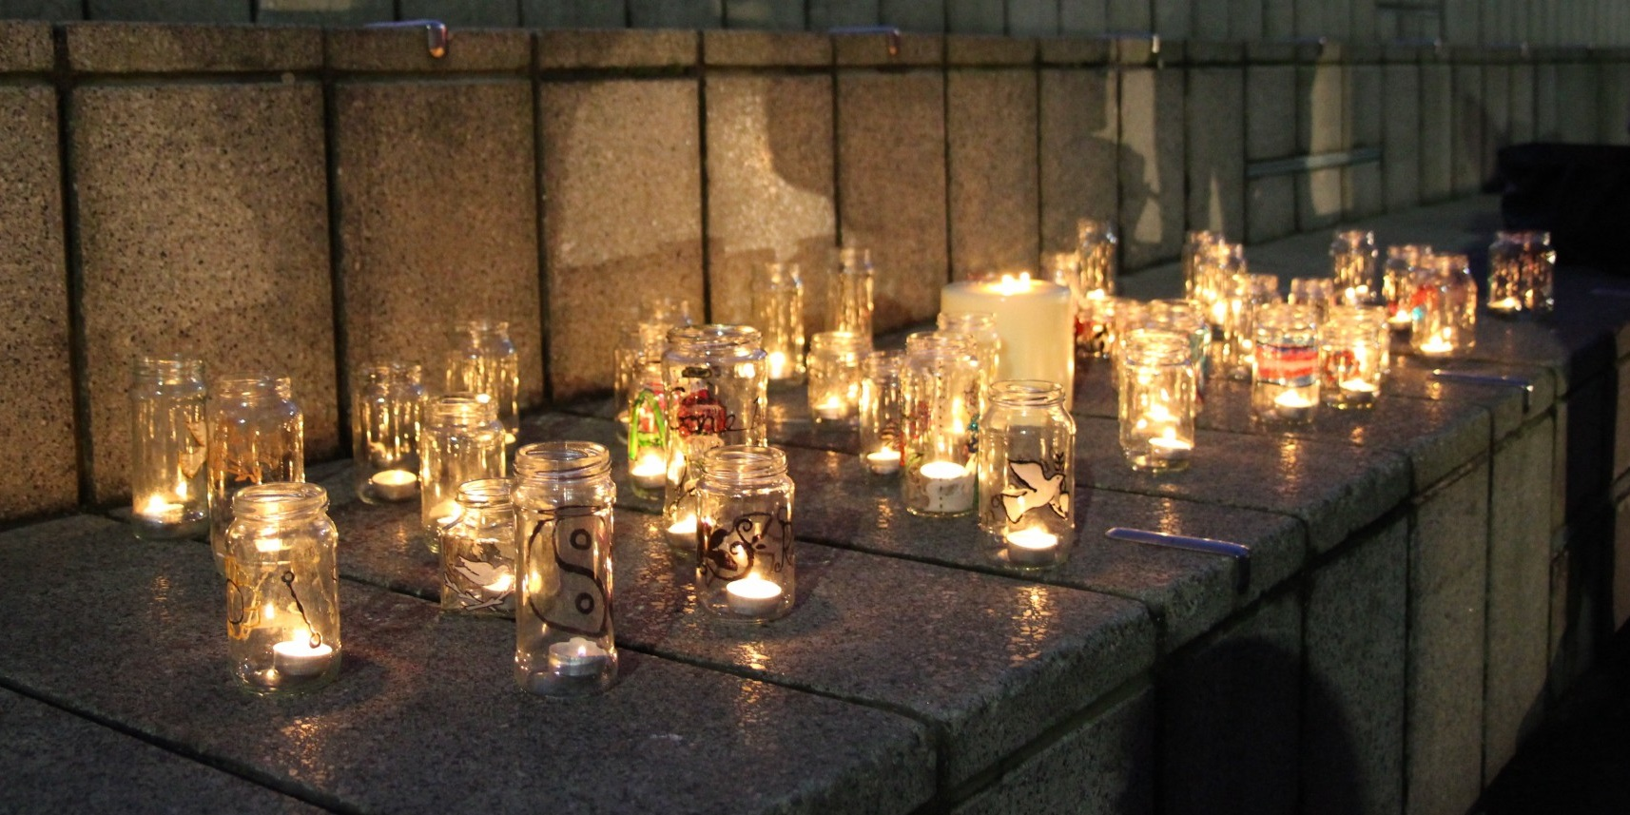
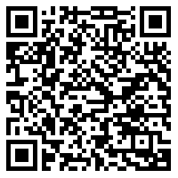
Trans Lives Matter: Remembering Our Dead Trans Day of Remembrance 2021
https://tdor.translivesmatter.info/reports/tdor2021

Slide 2
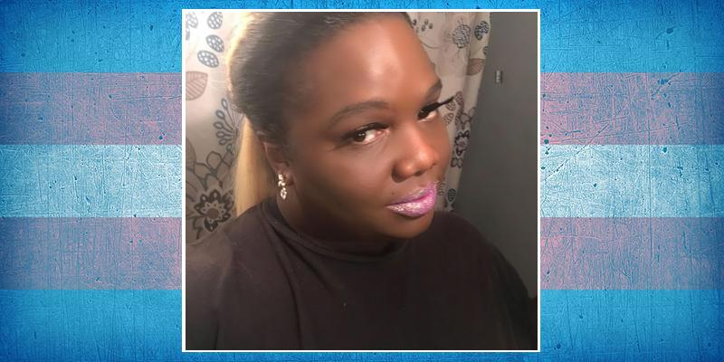
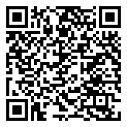
Felycya Harris Age 33 Augusta, Georgia (USA) shot. 3 Oct 2020

Slide 3
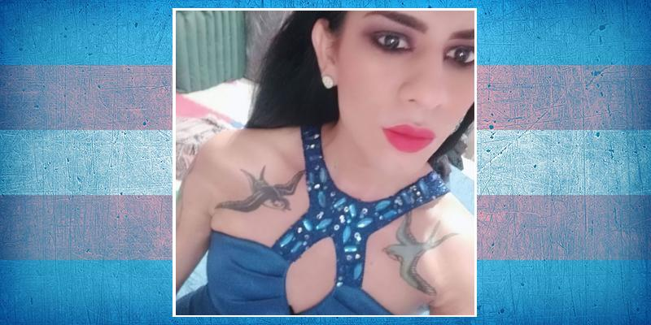
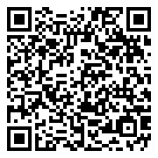
Gretell Ceballos Ramírez Age 34 Minatitlán, Veracruz (Mexico) shot. 3 Oct 2020

Slide 4
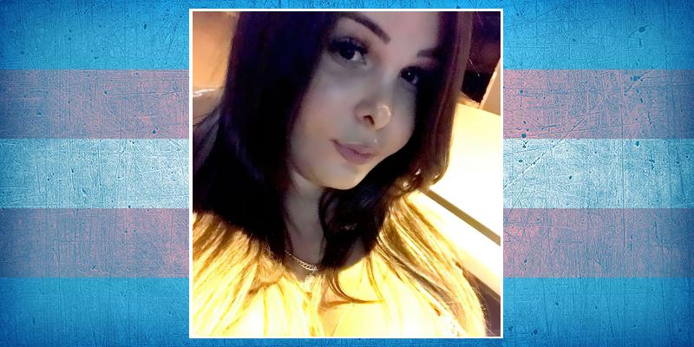
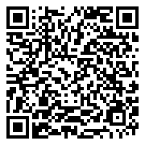
Nathalia Leticia Barbosa da Fonseca ("Bia") Age 26 São Pedro do Ivaí, Paraná (Brazil) shot. 3 Oct 2020

Slide 5
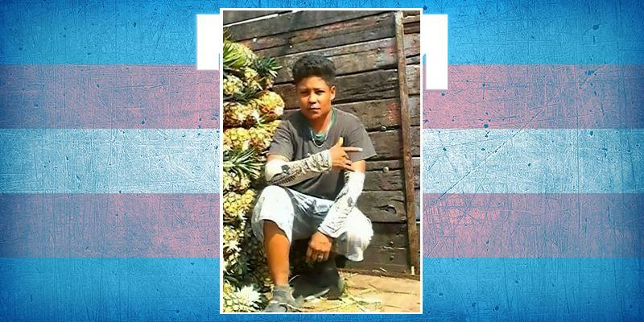
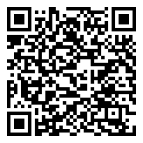
Erick Deseano Age 36 Ciudad Isla, Veracruz (Mexico) murdered. 4 Oct 2020

Slide 6
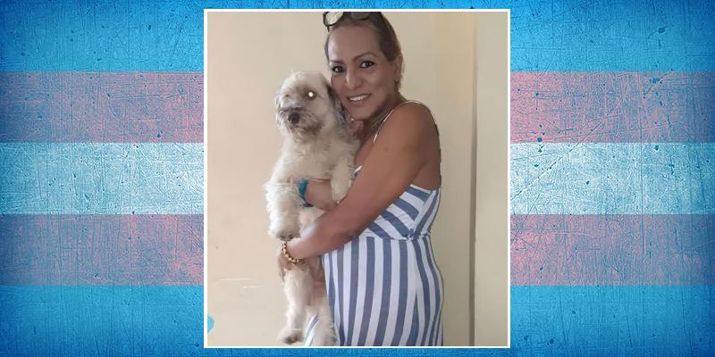
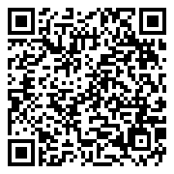
Antonella García Ramírez Age 51 Guayaquil, Guayas (Ecuador) stabbed. 4 Oct 2020

Slide 7

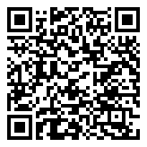
Marcos Age 17 Iztapalapa, Ciudad de México (Mexico) stabbed. 4 Oct 2020

Slide 8
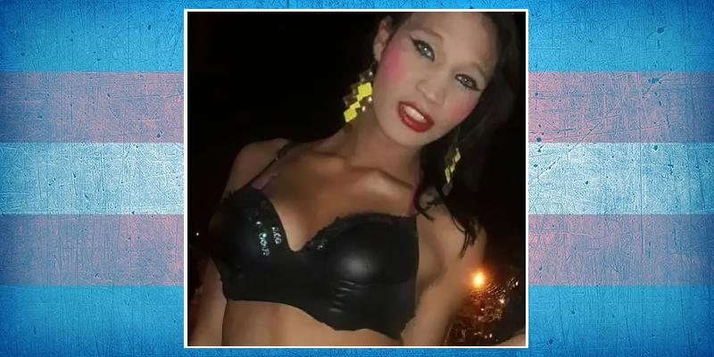
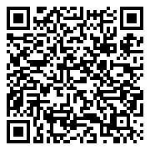
Michelle Ramos Alarcón ("Brenda") Age 26 Cartagena, Bolívar (Colombia) stabbed. 4 Oct 2020

Slide 9
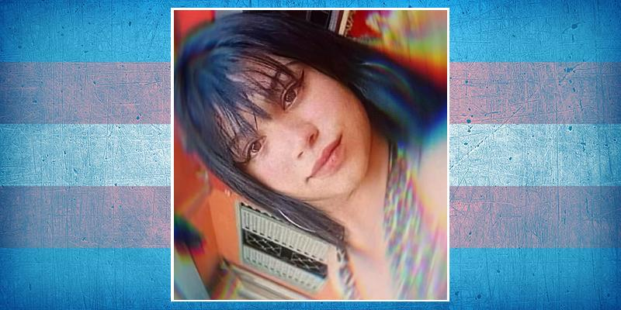
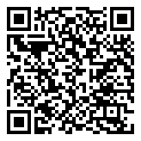
Paolla Bueno Age 17 Ibitinga, São Paulo (Brazil) stabbed. 5 Oct 2020

Slide 10
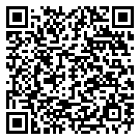
Bruna Age 27 Governador Valadares, Minas Gerais (Brazil) murdered. 6 Oct 2020

Slide 11
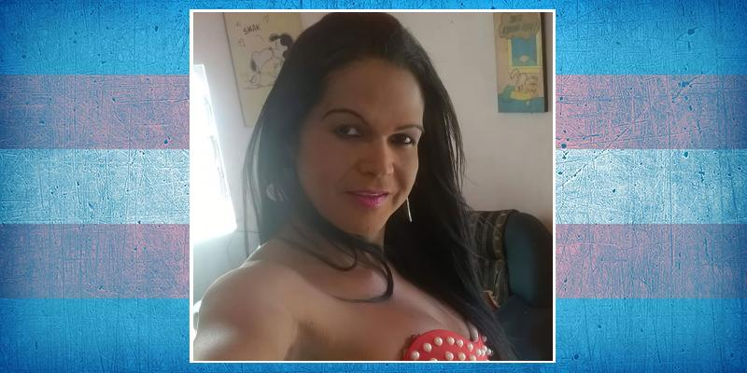
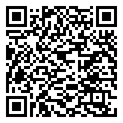
Adrianinha Paris Age 42 Recife, Pernambuco (Brazil) shot. 7 Oct 2020

Slide 12
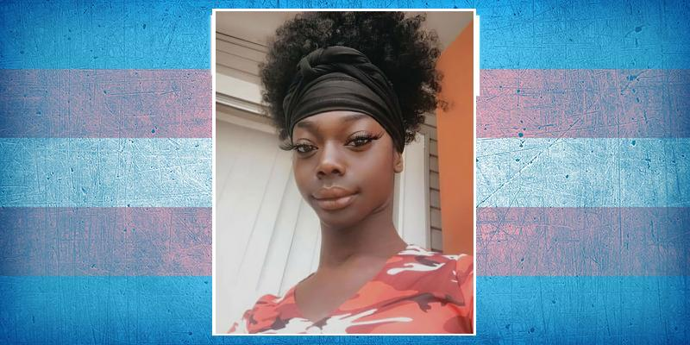
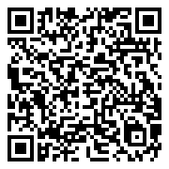
Brooklyn DeShauna Smith Age 20 Shreveport, Louisiana (USA) shot. 7 Oct 2020

Slide 13
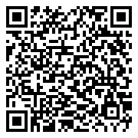
Name Unknown Age 25 Chicoloapan de Juárez, Estado de México (Mexico) stoned. 8 Oct 2020

Slide 14
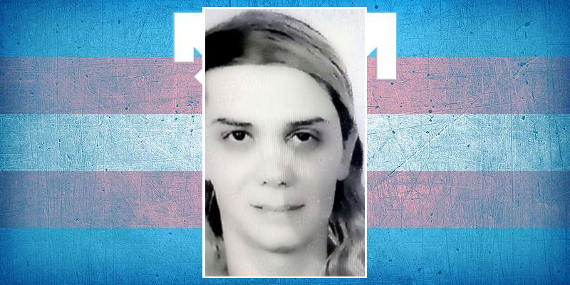
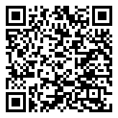
Selin Aynaci Age 42 Antalya (Turkey) murdered. 10 Oct 2020

Slide 15
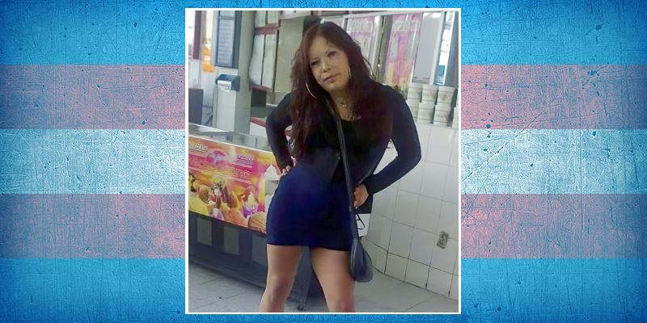
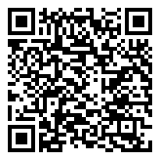
Susana Silvestre León Age 36 Tlajomulco de Zúñiga, Jalisco (Mexico) murdered. 10 Oct 2020

Slide 16

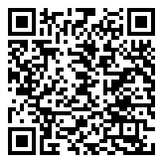
Sara Blackwood Age 29 Indianapolis (USA) shot. 11 Oct 2020

Slide 17
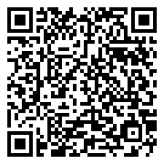
Name Unknown Age 25 Chicoloapan, Estado de México (Mexico) beaten and stoned. 13 Oct 2020

Slide 18
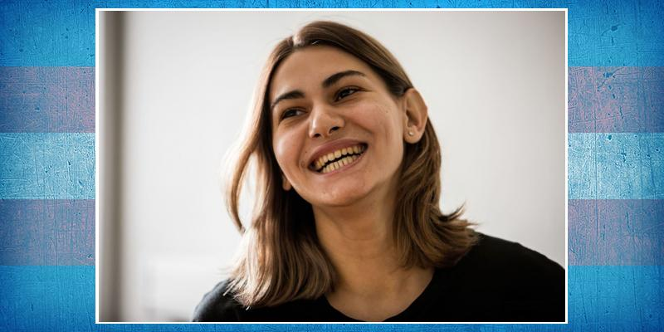
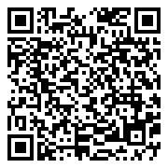
Viktoria Basakovskaya ("Vika") Age 23 Burmistrovo, Novosibirsk (Russia) strangled and mutilated. 13 Oct 2020

Slide 19
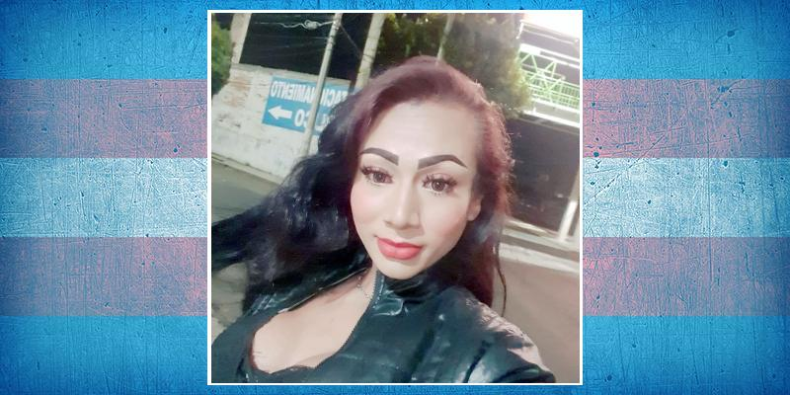
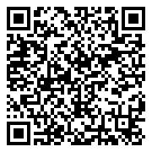
Aitiana Valeria Ramírez ("Lala") Age 29 Totolapan, Morelos (Mexico) murdered. 15 Oct 2020

Slide 20
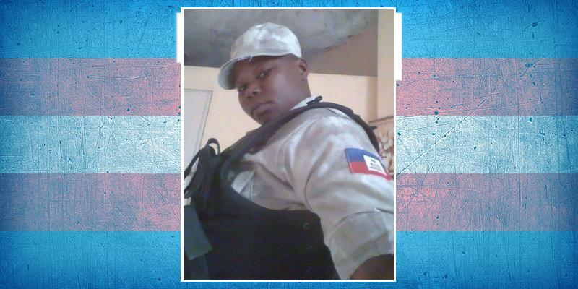
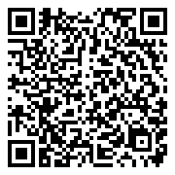
Mickerlange François Pétion-Ville, Port-au-Prince (Haiti) shot. 17 Oct 2020

Slide 21
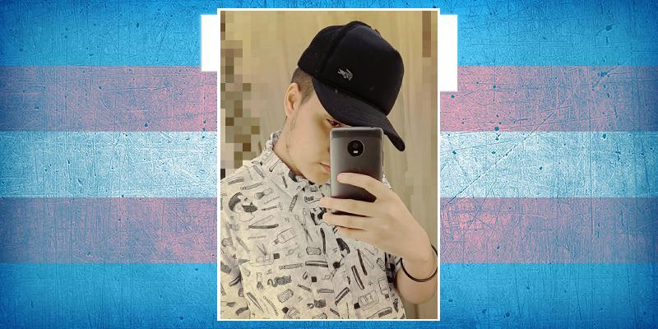
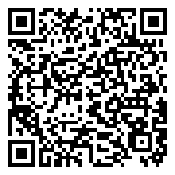
Yuri Arthur ("Aquariano") Belo Horizonte, Brazil (Brazil) suicide. 17 Oct 2020

Slide 22
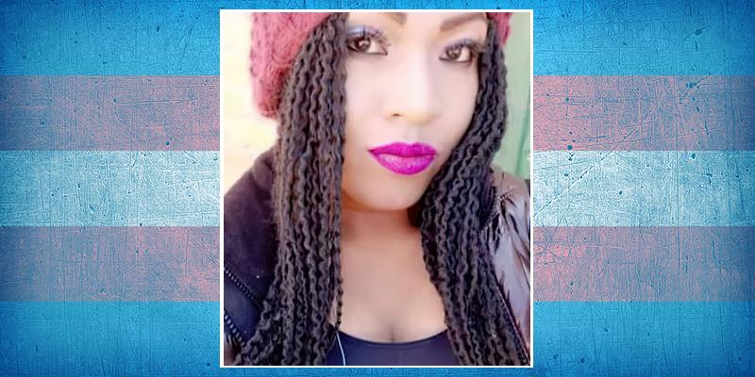
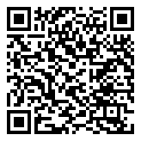
Gabriela Ramírez Age 19 El Alto, Le Paz (Bolivia) stabbed. 18 Oct 2020

Slide 23
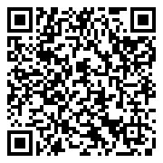
Name Unknown Age 20-25 Tlajomulco de Zúñiga, Jalisco (Mexico) stabbed. 18 Oct 2020

Slide 24
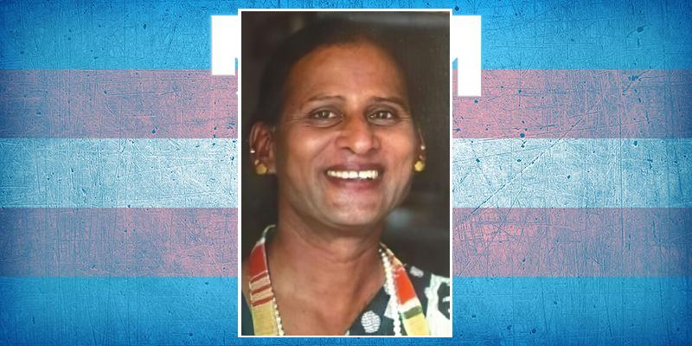
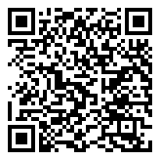
Sangeetha Age 59 Coimbatore, Tamil Nadu (India) stabbed. 21 Oct 2020

Slide 25
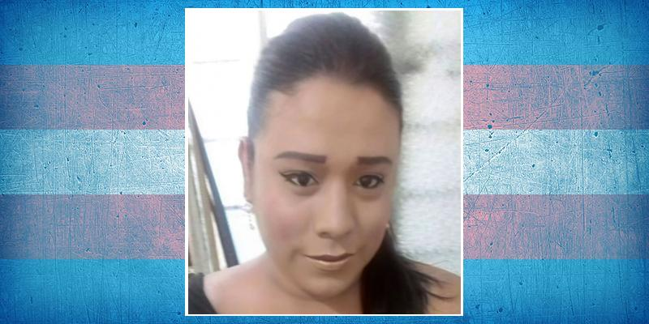
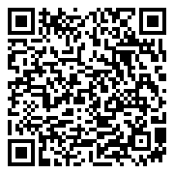
Violeta Ramírez Pérez Age 25 Tuxtla Gutiérrez, Chiapas (Mexico) 21 Oct 2020

Slide 26
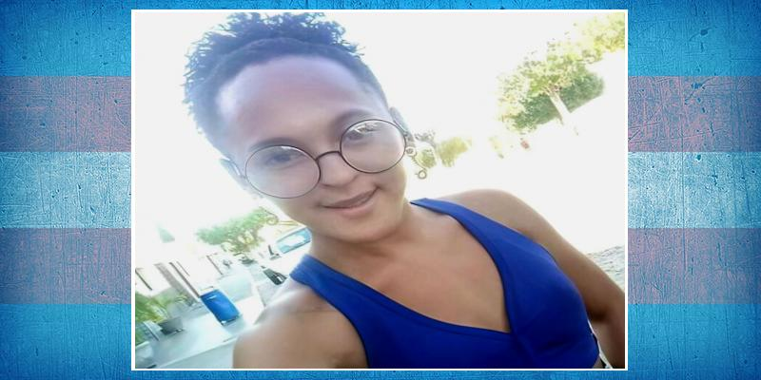
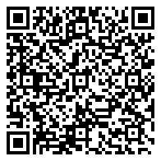
Bruna Marins de Oliveira Age 22 São José De Campestre, Rio Grande do Norte (Brazil) shot. 22 Oct 2020

Slide 27
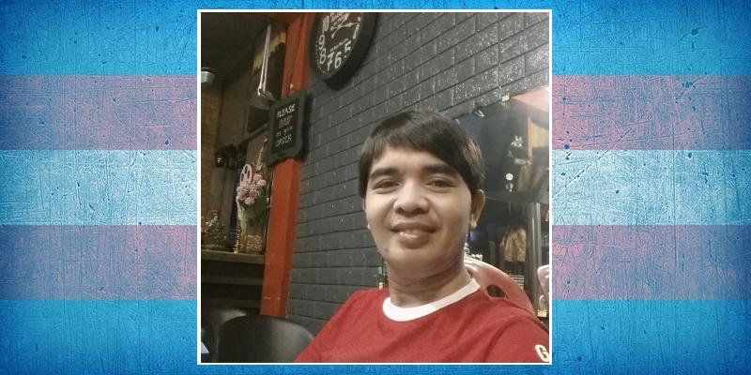
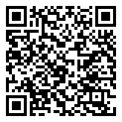
Emy Yruma Age 44 Malabon City, Luzon (Philippines) stabbed. 22 Oct 2020

Slide 28
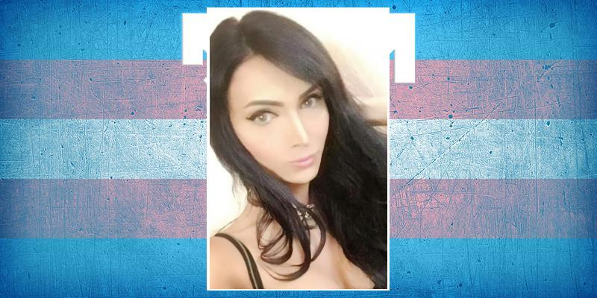
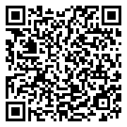
Bárbara Valencia ("Barbie") Age 25 La Paz, Baja California Sur (Mexico) stabbed. 23 Oct 2020

Slide 29


Natasha Nascimento Age 29 São Luís, Maranhão (Brazil) beaten. 24 Oct 2020

Slide 30


Angel Haynes ("Angel Unique") Age 25 Whitehaven, Memphis, Tennessee (USA) shot. 25 Oct 2020

Slide 31


Joana Domingos ("Joana D'Arc") Age 19 Rio Largo, Alagoas (Brazil) shot. 25 Oct 2020

Slide 32


Juliana Piropo Age 44 Vitória da Conquista, Bahia (Brazil) shot. 26 Oct 2020

Slide 33

Name Unknown Age 30 Toronto, Canada (Canada) died in custody. 26 Oct 2020

Slide 34

Arsalan Mianwali, Punjab (Pakistan) shot. 28 Oct 2020

Slide 35


Cristina Rodríguez Age 32 Quito (Ecuador) stabbed. 31 Oct 2020

Slide 36


Vicente González Lora Age 25 Valdivia, Los Rios (Chile) raped and suffocated. 31 Oct 2020

Slide 37


Samylla Marry Windson Praia de Iracema, Fortaleza, Ceará (Brazil) shot. 2 Nov 2020

Slide 38


Barbie dos Santos Age 44 Limeira, São Paulo (Brazil) 3 Nov 2020

Slide 39


Sandy da Silva Gomes Age 29 Tijucussu, Ceará (Brazil) shot. 4 Nov 2020

Slide 40


Skylar Heath Age 20 Liberty City, Miami, Florida (USA) shot. 4 Nov 2020

Slide 41


Alejandra Benitez ("La Power") Age 34 San Miguel de Tucumán (Argentina) shot. 5 Nov 2020

Slide 42

Name Unknown Chilpancingo, Guerrero (Mexico) strangled. 8 Nov 2020

Slide 43


Mía Zabala Gutiérrez ("Mía Colluchi") Playa Grande, Amapala, Valle (Honduras) beaten. 8 Nov 2020

Slide 44


Brisa Rafaela Dávila Rojas Age 48 Mar del Plata, Buenos Aires (Argentina) COVID-19. 9 Nov 2020

Slide 45


Ester Vogue Age 33 São Bernardo do Campo, São Paulo (Brazil) burned. 10 Nov 2020

Slide 46


Benjamin Bonin Alvinopolis, Minas Gerais (Brazil) suicide. 11 Nov 2020

Slide 47


Rafaela Bacchi Ribeirão Preto, São Paulo (Brazil) suicide. 11 Nov 2020

Slide 48

Name Unknown Manaus, Amazonas (Brazil) shot. 11 Nov 2020

Slide 49


Fendi Mon'ezah Armstrong ("Peaches") Age 39 Lithonia, Georgia (USA) shot. 12 Nov 2020

Slide 50


Soledad Rojas Paúcar ("Shisha") Age 48 El Tambo, Huancayo, Junin (Peru) stabbed. 12 Nov 2020

Slide 51


Juana Criollo Cabascango Age 51 La Roldós, Quito (Ecuador) stabbed. 14 Nov 2020

Slide 52


Daniela Ramos Guayaquil, Guayas (Ecuador) suffocated. 15 Nov 2020

Slide 53

Paquita Ferreira Brasil Age 17 Manaus, Amazonas (Brazil) 17 Nov 2020

Slide 54


Yunieski Carey Herrera ("Yuni") Age 34 Miami, Florida (USA) stabbed. 17 Nov 2020

Slide 55


Maya Borg Age 30 Tournai, Hainaut (Belgium) hypothermia. 18 Nov 2020

Slide 56


Sheila de Oliveira da Silva Age 27 João Pessoa, Paraíba (Brazil) suffocated. 18 Nov 2020

Slide 57


Asia Jynaé Foster Age 22 Houston, Texas (USA) shot. 20 Nov 2020

Slide 58


Maria Clara de Oliveira Sorocaba, São Paulo (Brazil) suicide. 20 Nov 2020

Slide 59


Kimberly Susan Fial Age 55 San Jose, California (USA) stabbed. 22 Nov 2020

Slide 60


Chae’Meshia Simms ("ChaeChae") Age 30 Richmond, Virginia (USA) shot. 23 Nov 2020

Slide 61


Bianca Pereira Marabá, Pará (Brazil) shot. 26 Nov 2020

Slide 62

Cristina Hernández Castillo ("La Bimbo") Age 26 Jáltipan, Veracruz (Mexico) shot. 27 Nov 2020

Slide 63


Camille Rocha Age 54 Patos de Minas, Minas Gerais (Brazil) COVID-19. 29 Nov 2020

Slide 64


Laura Salvador, Bahia (Brazil) shot. 29 Nov 2020

Slide 65


Mikaely Campion Manaus, Amazonas (Brazil) stabbed. 29 Nov 2020

Slide 66


Geovanna Ángulo Ramos Age 27 Santiago Suchilquitongo, Oaxaca (Mexico) beaten. 30 Nov 2020

Slide 67

Jhennyfer Age 56 Rio De Janeiro (Brazil) murdered. 30 Nov 2020

Slide 68


China Rivera Milan, Lombardy (Italy) possible suicide. 1 Dec 2020

Slide 69


Natasha Liverman Age 33 Iguala, Guerrero (Mexico) shot. 1 Dec 2020

Slide 70


Rayssa Eloá Menezes Lema ("Rah") Age 22 Alumínio, São Paulo (Brazil) murdered. 1 Dec 2020

Slide 71


Shirley Scarleth Villarreal ("Sherlyn") Santa María ExMarquesado, Oaxaca de Juárez (Mexico) shot. 1 Dec 2020

Slide 72


Johana Morena Mayor Age 49 Cali, Valle del Cauca (Colombia) murdered. 2 Dec 2020

Slide 73


G. Rocha Silva Age 18 Itarantim, Bahia (Brazil) shot. 5 Dec 2020

Slide 74

Name Unknown Chilpancingo, Guerrero (Mexico) strangled. 6 Dec 2020

Slide 75


Alejandra Villa Salazar Age 54 Balvanera, Buenos Aires (Argentina) asphixiated. 7 Dec 2020

Slide 76


Bruna Gomes Araújo ("Bruna Tenório") Age 25 Jacaré dos Homens, Alagoas (Brazil) stoned. 7 Dec 2020

Slide 77


Tati Quirós Dávila Age 20 Playas del Coco, Guanacaste (Costa Rica) shot. 7 Dec 2020

Slide 78


Vicenta de Loris ("La Chenta") Age 64 Iguala, Guerrero (Mexico) shot. 8 Dec 2020

Slide 79

Name Unknown Age 40 Serra, Espirito Santo (Brazil) burned. 8 Dec 2020

Slide 80


Karen Cristina ("Kareen Vitória") Age 18 São Paulo (Brazil) murdered. 9 Dec 2020

Slide 81


Juliana da Cruz Costa Age 33 Cruzeiro, Distrito Federal (Brazil) stabbed. 10 Dec 2020

Slide 82


Paula Brandão Piracicaba, São Paulo (Brazil) murdered. 11 Dec 2020

Slide 83


Bridget Flack Age 28 Melbourne, Victoria (Australia) possible suicide. 11 Dec 2020

Slide 84

Sudarshan Suryavanshi Age 21 Latur, Maharashtra (India) beaten. 11 Dec 2020

Slide 85


Marcela Estella Vieira Age 24 Colniza, Mato Grosso (Brazil) shot. 12 Dec 2020

Slide 86


Nataly Lily Age 23 Mogi das Cruzes, São Paulo (Brazil) shot. 12 Dec 2020

Slide 87

Duda Age 29 Caucaia, Ceará (Brazil) stabbed. 13 Dec 2020

Slide 88


Jaheim Bella Pugh Age 19 Prichard, Alabama (USA) shot. 13 Dec 2020

Slide 89


Avril ("Luna") Age 17 Lille, Nord (France) suicide. 15 Dec 2020

Slide 90

Maria Karachi, Sindh (Pakistan) stabbed. 15 Dec 2020

Slide 91


Fonthoi Lima Indaiatuba, São Paulo (Brazil) suicide. 16 Dec 2020

Slide 92


Yaelin Maydana Olmedo Age 31 Bahía Blanca, Buenos Aires (Argentina) strangled. 16 Dec 2020

Slide 93

Name Unknown Natal, Rio Grande do Norte (Brazil) murdered. 17 Dec 2020

Slide 94


Allex Noah Russas, Ceará (Brazil) suicide. 18 Dec 2020

Slide 95

Name Unknown Boituva, São Paulo (Brazil) 19 Dec 2020

Slide 96


Myliah Monae Mullen Baltimore, Maryland (USA) suicide. 20 Dec 2020

Slide 97


Wanessa Sampaio Age 22 São Paulo (Brazil) stabbed. 20 Dec 2020

Slide 98

Name Unknown Panaji, Goa (India) murdered. 20 Dec 2020

Slide 99


Alejandra Zayas Lara ("Ale") Age 26 Puebla (Mexico) stabbed. 21 Dec 2020

Slide 100


Oreinha Age 21 Cruzeiro do Sul, Rio Largo, Alagoas (Brazil) beaten. 22 Dec 2020

Slide 101


Iratxe Otero Age 29 Costa del Silencio, Arona, Santa Cruz de Tenerife (Spain) stabbed. 24 Dec 2020

Slide 102


Courtney "Eshay" Key Age 25 Chicago, Illinois (USA) shot. 25 Dec 2020

Slide 103


J. A. da Silva Age 26 Cascavel, Ceará (Brazil) shot. 25 Dec 2020

Slide 104

Alexandria Winchester Age 24 The Bronx, New York (USA) shot. 26 Dec 2020

Slide 105


Kimberely Patricia Cope ("Kim") Age 40 Athens, Georgia (USA) 27 Dec 2020

Slide 106

H. J. Ramírez ("La Tigra") Age 46 Guayaquil, Guayas (Ecuador) suffocated. 28 Dec 2020

Slide 107


Nelly García Rivera Age 28 Poza Rica, Veracruz (Mexico) stabbed and mutilated. 28 Dec 2020

Slide 108


Ericka Ipiales, Nariño (Colombia) beaten and stabbed. 30 Dec 2020

Slide 109


Bonaire Black ("Bonni") Age 18 Atlanta, Georgia (USA) 31 Dec 2020

Slide 110

Sapa Age 36 Mansehra, Khyber Pakhtunkhuwa (Pakistan) murdered. 1 Jan 2021

Slide 111

Andressa das Chaga São Roque, São Paulo (Brazil) beaten. 2 Jan 2021

Slide 112


Samantha Riaño Morales ("Sammy") Mariquita, Tolima (Colombia) shot. 2 Jan 2021

Slide 113


Keron Ravach Age 13 Camocim, Ceará (Brazil) kicked, beaten and stabbed. 4 Jan 2021

Slide 114


Tyianna "Davarea" Alexander Age 28 Chicago, Illinois (USA) shot. 6 Jan 2021

Slide 115


Duda Laif Age 52 Bagé, Rio Grande do Sul (Brazil) murdered. 6 Jan 2021

Slide 116


Lupita Moraes da Silva São João do Arraial, Piauí (Brazil) stabbed. 7 Jan 2021

Slide 117

Name Unknown Acapulco, Guerrero (Mexico) beaten. 8 Jan 2021

Slide 118


Samuel Edmund Damián Valentín Trujillo Alto, Puerto Rico (USA) shot. 9 Jan 2021

Slide 119

Tobias Palmer ("Benji") Somerville, Massachusetts (USA) 9 Jan 2021

Slide 120


Natalia Maldonado Age 24 Granadero Baigorria, Santa Fe (Argentina) shot. 10 Jan 2021

Slide 121


Angelita Alves Correia Age 31 Matosinhos, Norte (Portugal) 11 Jan 2021

Slide 122


Daisy del Carmen Age 35 Ciudad Victoria, Tamaulipas (Mexico) suicide. 12 Jan 2021

Slide 123


Natasha Kieanna Age 37 Detroit, Michigan (USA) 12 Jan 2021

Slide 124


Nicolly Fernanda Age 25-30 Fazenda Rio Grande, Paraná (Brazil) stabbed. 12 Jan 2021

Slide 125


Erika Endrina Tagaytay City, Luzon (Philippines) murdered. 13 Jan 2021

Slide 126


Nicole Quilaneta Tagaytay City, Luzon (Philippines) murdered. 13 Jan 2021

Slide 127


RR Bondoc Tagaytay City, Luzon (Philippines) murdered. 13 Jan 2021

Slide 128

Guddu Zaman Age 45 Karachi, Sindh (Pakistan) tortured. 15 Jan 2021

Slide 129


Malevola Lessa ("Leticia") Mesquita, Rio de Janeiro (Brazil) shot. 15 Jan 2021

Slide 130


Mimii Lessa ("Yasmin") Mesquita, Rio de Janeiro (Brazil) shot. 15 Jan 2021

Slide 131


Bianca Bankz ("Muffin") Atlanta, Georgia (USA) murdered. 17 Jan 2021

Slide 132


Dayanna Scarlett Age 20 Tepic, Nayarit (Mexico) shot. 17 Jan 2021

Slide 133


Luciana Sandreli Alves Colatina, Espirito Santo (Brazil) suicide. 17 Jan 2021

Slide 134


Gala Ocampo Figueroa Age 28 Amacuzac, Morelos (Mexico) shot. 18 Jan 2021

Slide 135


Gianna Lombardi Age 48 Andria, Barletta-Andria-Trani (Italy) 18 Jan 2021

Slide 136


Naomi Alonso Age 47 Chalco, Estado de México (Mexico) tortured. 21 Jan 2021

Slide 137

Name Unknown Pernambuco (Brazil) suicide. 23 Jan 2021

Slide 138


Dominique Jackson Age 30 Jackson, Mississippi (USA) shot. 25 Jan 2021

Slide 139

F. Escalante Age 35 Dumaguete City, Visayas (Philippines) shot. 26 Jan 2021

Slide 140


Sandie Crisp ("Goddess Bunny") Age 61 Los Angeles, California (USA) COVID-19. 27 Jan 2021

Slide 141


Ygona Moura Age 23 São Paulo (Brazil) COVID-19. 27 Jan 2021

Slide 142


Valentina Vera López ("Kim") Age 32 Puerto Montt, Los Lagos (Chile) pulmonary embolism. 27 Jan 2021

Slide 143

Name Unknown Age 27 Texcoco, Estado de México (Mexico) murdered. 27 Jan 2021

Slide 144


Fifty Bandz Age 21 Baton Rouge, Louisiana (USA) shot. 28 Jan 2021

Slide 145


Verónica Solano Bogotá, Distrito Capital (Colombia) stabbed. 28 Jan 2021

Slide 146


Michele Almeida Age 45 Contagem, Minas Gerais (Brazil) stabbed. 29 Jan 2021

Slide 147


Lucho Ávila Age 25 Los Hornos, Buenos Aires (Argentina) died in custody. 1 Feb 2021

Slide 148


Duda dos Santos Age 19 Itajaí, Santa Catarina (Brazil) shot. 2 Feb 2021

Slide 149


Amandha Fagundes ("Mandhy") Age 34 Piracicaba, São Paulo (Brazil) murdered. 3 Feb 2021

Slide 150


Alexus Braxton (Kimmy Icon Braxton) Age 45 Miami, Florida (USA) murdered. 4 Feb 2021

Slide 151


Úrsula A. S. ("Maravilhosa") Age 23 Porto Velho, Rondônia (Brazil) COVID-19. 4 Feb 2021

Slide 152


Giselle Sakai Age 32 João Pessoa, Paraíba (Brazil) pulmonary embolism. 5 Feb 2021

Slide 153


Alessandra Ferrati Age 19 Punata, Cochabamba (Bolivia) strangled. 6 Feb 2021

Slide 154


Angie Priscila Jeaniot Arévalo Age 35 Sincelejo, Sucre (Colombia) stabbed. 6 Feb 2021

Slide 155


Giovanna Betancourth Vergara Cali, Valle de Cauca (Colombia) murdered. 6 Feb 2021

Slide 156

Nicolas Age 25-26 Le Havre, Seine-Maritime (France) suicide. 7 Feb 2021

Slide 157


Natasha Santos Age 16 Aracaju, Sergipe (Brazil) beaten. 8 Feb 2021

Slide 158


Alexander Blake VanDalsen Age 21 Lafayette, Indiana (USA) 9 Feb 2021

Slide 159


Sneha Age 34 Kannur, Kerala (India) suicide. 9 Feb 2021

Slide 160


Luna Abascal (Getsemaní Santos Luna) Cosoleacaque, Veracruz (Mexico) shot. 11 Feb 2021

Slide 161


Andrea Néstor Moreno Castillo Age 32 Calarcá, Quindío (Colombia) stabbed. 12 Feb 2021

Slide 162

Camila Age 29 Comonfort, Guanajuato (Mexico) shot. 12 Feb 2021

Slide 163


Pojuca Alves de Souza Age 26 Araci, Bahia (Brazil) stabbed. 12 Feb 2021

Slide 164


Diana Miranda/Paola Ferrati Age 35 Ciudad de México (Mexico) stabbed. 13 Feb 2021

Slide 165


Manuella Otto Age 25 Manaus, Amazonas (Brazil) shot. 13 Feb 2021

Slide 166

L. E. Parama Age 29 Manila, Luzon (Philippines) shot. 14 Feb 2021

Slide 167


Brianna Kamila Espinosa Sanchez ("Kami") Yumbo, Valle del Cauca (Colombia) shot. 15 Feb 2021

Slide 168


Gerusa Oliveira Reis Age 32 Santo Antonio de Jesus, Bahia (Brazil) shot. 15 Feb 2021

Slide 169


Emilia Herrera Obrecht ("Bau") Age 25 Panguipulli, Los Rios (Chile) shot. 16 Feb 2021

Slide 170


Lucca Gomes Souto Age 23 Naque, Minas Gerais (Brazil) suicide. 17 Feb 2021

Slide 171


Chyna Carrillo Age 24 New Wilmington, Pennsylvania (USA) beaten and stabbed. 18 Feb 2021

Slide 172


Àlissia Rodriguez Maceió, Alagoas (Brazil) strangled. 19 Feb 2021

Slide 173


Saulette Tarimoro, Guanajuato (Mexico) beaten and stabbed. 20 Feb 2021

Slide 174


Jasmine Bright ("Jazzy") Age 22 Ambridge, Pennsylvania (USA) shot. 21 Feb 2021

Slide 175


Jeffrey Bright ("JJ") Age 16 Ambridge, Pennsylvania (USA) shot. 21 Feb 2021

Slide 176

J. F. Medina Hernández Age 25 Ciudad Lerdo, Durango (Mexico) run over. 21 Feb 2021

Slide 177


Lorena Muniz Age 25 São Paulo (Brazil) clinical neglect. 21 Feb 2021

Slide 178


Natasha da Paz Gomes Feira de Santana, Bahia (Brazil) shot. 23 Feb 2021

Slide 179


Jenna Franks Age 34 Jacksonville, North Carolina (USA) murdered. 24 Feb 2021

Slide 180

Surya Age 38 Mumbai, Maharashtra (India) stabbed. 24 Feb 2021

Slide 181


Andressa Pimentel ("India") Marabá, Pará (Brazil) shot. 25 Feb 2021

Slide 182


Eva Carvalho Age 17 Timbaúba, Pernambuco (Brazil) shot. 25 Feb 2021

Slide 183


Kimberly Wirtz ("Tova") Baltimore, Maryland (USA) died in custody. 26 Feb 2021

Slide 184


Xingshun Zhou Age 24 Echt, Limburg (Netherlands) suicide. 26 Feb 2021

Slide 185


Julie Catamin Age 49 Tapaz, Capiz, Visayas (Philippines) shot. 28 Feb 2021

Slide 186


Dolphin Kohat, Khyber Pakhtunkhwa (Pakistan) shot. 1 Mar 2021

Slide 187

Nicolas Age 15 Rio Grande, Tierra del Fuego (Argentina) suicide. 2 Mar 2021

Slide 188


Byun Hee-soo Age 23 Cheongju, North Chungcheong (South Korea) suicide. 3 Mar 2021

Slide 189


Diamond Kyree Sanders/Diamond Nicole Age 23 Cincinnati, Ohio (USA) shot. 3 Mar 2021

Slide 190


Fabiola Pamela Ramírez Age 22 Resistencia, Chaco (Argentina) murdered. 3 Mar 2021

Slide 191


Lala Contreras Age 20 Somotillo, Chinandega (Nicaragua) tortured and stoned. 3 Mar 2021

Slide 192

Name Unknown Age 35 Ciudad Delgado, San Salvador (El Salvador) strangled. 3 Mar 2021

Slide 193


Mikelly Câmara Age 25 Cachoeiro de Itapemirim, Espírito Santo (Brazil) shot. 4 Mar 2021

Slide 194


Natali Sofía Martínez Grabados Age 22 Bogotá, Distrito Capital (Colombia) cosmetic surgery complications. 4 Mar 2021

Slide 195

Name Unknown Age 15 Perth, Western Australia (Australia) suicide. 4 Mar 2021

Slide 196


Jesús Ochandio ("La Ochandio") Age 68 Mar del Plata, Buenos Aires (Argentina) stabbed. 6 Mar 2021

Slide 197


Alexandra Monteiro (Alexandra Corrêa de Oliveira) Age 30 Cuiabá, Matto Grosso (Brazil) murdered. 7 Mar 2021

Slide 198


Tainá Vitória da Conquista, Bahia (Brazil) 7 Mar 2021

Slide 199

Name Unknown Piraquara, Paraná (Brazil) stabbed. 8 Mar 2021

Slide 200

Drika Rodrigues Sales Age 26 Manaus, Amazonas (Brazil) shot. 10 Mar 2021

Slide 201

Itu dos Santos Age 30 Salvador, Bahia (Brazil) shot. 10 Mar 2021

Slide 202

Milo Turner Plymouth, Devon (United Kingdom) suicide. 10 Mar 2021

Slide 203


Miraş Güneş Age 36 İzmir (Turkey) beaten. 11 Mar 2021

Slide 204


Luana Menndes/Luana Pereira dos Santos Age 26 Volta Redonda, Rio de Janeiro (Brazil) shot. 12 Mar 2021

Slide 205


Paola Calderon Age 24 Cuautla, Morelos (Mexico) beaten and shot. 15 Mar 2021

Slide 206

Kerollyn Moroe Shampherllay Age 49 Dourados, Mato Grosso do Sul (Brazil) 17 Mar 2021

Slide 207


Rayanna Pardo Age 26 Los Angeles, California (USA) run over. 17 Mar 2021

Slide 208


Aidelen Evans Age 24 Port Arthur, Texas (USA) 18 Mar 2021

Slide 209

Name Unknown Age 30 Manzanillo, Colima (Mexico) shot. 19 Mar 2021

Slide 210


Luana Katrina Brazil suicide. 20 Mar 2021

Slide 211

Niharika Narasimhamurthy Age 35 Hindupur, Andhra Pradesh (India) stabbed and burned. 20 Mar 2021

Slide 212


La Gasparina Atlixco, Puebla (Mexico) stabbed. 21 Mar 2021

Slide 213


Piper Autumn Rivers (Tegan Toxik/Tegan Last) Age 35 Las Vegas, Nevada (USA) suicide. 22 Mar 2021

Slide 214

Name Unknown Age 49 São Paulo (Brazil) suicide. 22 Mar 2021

Slide 215


Nathally Mendes Alves Age 31 Guaíra, São Paulo (Brazil) 26 Mar 2021

Slide 216


Daniela ("Sirenita Riascos") Age 19 Buga, Valle de Cauca (Colombia) stabbed. 28 Mar 2021

Slide 217


Krys Brandon Ruiz Age 26 Lompoc, California (USA) shot. 28 Mar 2021

Slide 218


Vanessa Zúniga Age 43 Tela, Atlántida (Honduras) throat cut. 28 Mar 2021

Slide 219


Kim Ramirez Age 20-25 New York (USA) 28 Mar 2021

Slide 220


Débora Loven Stayne Age 44 Barbalha, Ceará (Brazil) run over. 29 Mar 2021

Slide 221

Jennifer Zapata Age 23 Ciudada Juarez, Chihuahua (Mexico) tortured. 30 Mar 2021

Slide 222

Bobby Age 40 Lahore, Punjab (Pakistan) tortured. 31 Mar 2021

Slide 223


Jaida Peterson Age 24 Charlotte, North Carolina (USA) shot. 4 Apr 2021

Slide 224


Fanny Nilópolis, Rio de Janeiro (Brazil) fell from a vehicle. 5 Apr 2021

Slide 225

Mumtaz Age 60 Karachi, Sindh (Pakistan) shot. 5 Apr 2021

Slide 226


Pietra Valentina Age 16 Juazeiro do Norte, Ceará (Brazil) stabbed. 5 Apr 2021

Slide 227


Vida Bruno Age 44 Salvador, Bahia (Brazil) beaten. 6 Apr 2021

Slide 228

Bubbli Taxila, Punjab (Pakistan) shot. 7 Apr 2021

Slide 229


Madalena Leite Age 64 Piracicaba, São Paulo (Brazil) murdered. 7 Apr 2021

Slide 230


Paula Migeon Age 50 Reims, Marne (France) raped and stabbed. 7 Apr 2021

Slide 231


Dominique Lucious Age 26 Springfield, Missouri (USA) shot. 8 Apr 2021

Slide 232


Marcinha Vaz ("Maquita") Age 30 Macapá, Amapá (Brazil) shot. 8 Apr 2021

Slide 233


Dimitra Kalogiannis Age 64 Athens, Attica (Greece) run over. 9 Apr 2021

Slide 234


Márcia Marcita Age 48 Ribeirão Preto, São Paulo (Brazil) murdered. 9 Apr 2021

Slide 235

Name Unknown Age 30-35 Villa de Álvarez, Colima (Mexico) shot. 9 Apr 2021

Slide 236


Kendra Zambrano ("La Kendra"/"La Barbie") Age 23 Pénjamo, Guanajuato (Mexico) shot. 10 Apr 2021

Slide 237


Milena Massafera Age 34 Ribeirão Preto, São Paulo (Brazil) stabbed. 10 Apr 2021

Slide 238


Sofía Micaela Catán ("Mica") Age 24 Santiago del Estero (Argentina) burned. 11 Apr 2021

Slide 239

Name Unknown Age 17 Muriaé, Minas Gerais (Brazil) murdered. 11 Apr 2021

Slide 240

Name Unknown Maracanaú, Ceará (Brazil) shot. 11 Apr 2021

Slide 241


Josefina Cruceño Age 28 Ciudad de Mendoza (Argentina) drowned. 12 Apr 2021

Slide 242

Pet Galea Age 35 Iloilo City, Visayas (Philippines) stabbed. 12 Apr 2021

Slide 243


Larissa Dieckmann ("Lara") Niterói, Rio de Janeiro (Brazil) COVID-19. 13 Apr 2021

Slide 244

Stefany Rio de Janeiro (Brazil) murdered. 13 Apr 2021

Slide 245


Yeray Hurtado ("Teresa") Cali, Valle del Cauca (Colombia) murdered. 13 Apr 2021

Slide 246


Arvenly Madrijanon Age 35 Koronadal City, Mindanao (Philippines) murdered. 14 Apr 2021

Slide 247


Luisa Revilla Urcia Age 49 Trujillo, La Libertad (Peru) COVID-19. 15 Apr 2021

Slide 248


Remy Fennell Age 28 Charlotte, North Carolina (USA) shot. 15 Apr 2021

Slide 249


Melibeth Yulitza Marchena Age 44 Fundación, Magdalena (Colombia) shot. 15 Apr 2021

Slide 250


Yara Cumady/Yara Pereira dos Santos Age 24 Frutal, Minas Gerais (Brazil) run over. 17 Apr 2021

Slide 251


Viki Nieva Age 33 Aguilares, Tucumán (Argentina) stabbed. 18 Apr 2021

Slide 252


Juliana Santos Age 22 Porto Vehlo, Rondônia (Brazil) cosmetic filler complications. 19 Apr 2021

Slide 253


Monalisa Leide Age 41 Macapá, Amapá (Brazil) stabbed. 20 Apr 2021

Slide 254


Tiara Banks Age 24 Chicago, Illinois (USA) shot. 21 Apr 2021

Slide 255

Channu Age 25 Lahore, Punjab (Pakistan) murdered and burned. 21 Apr 2021

Slide 256


Iris Santos Age 22 Houston, Texas (USA) shot. 23 Apr 2021

Slide 257


Natalia Smüt Lopez Age 24 San Jose, California (USA) shot. 23 Apr 2021

Slide 258


Andresa Santos Age 36 Manaus, Amazonas (Brazil) beaten. 24 Apr 2021

Slide 259


Tiffany Thomas Age 38 Dallas, Texas (USA) shot. 24 Apr 2021

Slide 260

F. de Assis Braga de Oliveira Age 42 Ji-Paraná, Rondônia (Brazil) beaten. 25 Apr 2021

Slide 261


Sharlotte Escobar Ramos Age 54 Comitán, Chiapas (Mexico) stoned. 25 Apr 2021

Slide 262


Silvana Gómez Galeano Age 25 Neiva, Huila (Colombia) cosmetic filler complications. 25 Apr 2021

Slide 263


Zashy Zuely del Cid Velásquez Age 27 San Miguel (El Salvador) shot. 25 Apr 2021

Slide 264


Emanuelly Castro Age 26 Cedral, São Paulo (Brazil) beaten. 26 Apr 2021

Slide 265


Luana Morais Age 20 Juazeiro do Norte, Ceará (Brazil) shot. 27 Apr 2021

Slide 266


J. S. Cardoso Age 21 Parauapebas, Pará (Brazil) shot. 28 Apr 2021

Slide 267


Jaqueline Saviery Silva Age 30 Alfenas, Minas Gerais (Brazil) shot. 30 Apr 2021

Slide 268


Keri Washington ("Bobo") Age 49 Clearwater, Florida (USA) murdered. 1 May 2021

Slide 269

Name Unknown Age 25-30 Chilpancingo, Guerrero (Mexico) shot. 1 May 2021

Slide 270


Jahaira DeAlto Balenciaga Age 42 Boston, Massachusetts (USA) stabbed. 2 May 2021

Slide 271


T. Hardin Age 35 York, South Carolina (USA) shot. 2 May 2021

Slide 272


Whispering Wind Bear Spirit Age 41 York, Pennsylvania (USA) shot. 3 May 2021

Slide 273


Danny Henson Age 31 Baltimore, Maryland (USA) shot. 4 May 2021

Slide 274


Sophie Vásquez Age 36 Brookhaven, Georgia (USA) shot. 4 May 2021

Slide 275

Name Unknown Hueyapan de Ocampo, Veracruz (Mexico) beaten. 5 May 2021

Slide 276


Danielle Boachie ("Dani")/Mistress Velvet Age 33 Chicago, Illinois (USA) suicide. 8 May 2021

Slide 277


Serenity Hollis Age 24 Albany, Georgia (USA) shot. 8 May 2021

Slide 278

Aliya Age 33 Jamshedpur, Jharkhand (India) suicide. 9 May 2021

Slide 279


Cielo de Lucca Age 20-22 La Plata, Buenos Aires (Argentina) shot. 10 May 2021

Slide 280


Reyna Fernandez Villanueva ("Reira Saga") Age 27 Nauta, Loreto (Peru) stabbed. 10 May 2021

Slide 281

Name Unknown Age 30 Piacenza (Italy) 11 May 2021

Slide 282

Name Unknown Ciudad Juarez, Chihuahua (Mexico) shot. 12 May 2021

Slide 283


Nona Moselle Conner Age 32 Washington, D.C. (USA) 13 May 2021

Slide 284

S. Saira Mamani Age 24 Arequipa (Peru) cosmetic filler complications. 13 May 2021

Slide 285


Rany Merces ("Nynha") Belo Horizonte, Minas Gerais (Brazil) COVID-19. 13 May 2021

Slide 286


Titi das Chagas Age 27 Afonso Bezerra, Rio Grande do Norte (Brazil) stoned. 14 May 2021

Slide 287


Valery Pereira Age 23 La Lima, Cortés (Honduras) stoned. 14 May 2021

Slide 288


Jhie Bangkiao Leyte (Philippines) murdered. 15 May 2021

Slide 289


Eliana Castillo Bogotá, Distrito Capital (Colombia) stabbed. 17 May 2021

Slide 290


Giselle Hartzog/Giselle Hilton Age 30 Washington, D.C. (USA) 18 May 2021

Slide 291


Name Unknown Rio Grande do Norte (Brazil) suicide. 18 May 2021

Slide 292


Oliver Taylor ("Ollie") Age 17 Gervais, Oregon (USA) shot. 19 May 2021

Slide 293


Roberta Fernandes Age 32 Luís Eduardo Magalhães, Bahia (Brazil) stabbed. 19 May 2021

Slide 294

Name Unknown Tlaquepaque, Jalisco (Mexico) 19 May 2021

Slide 295


Ebeng Mayor Quezon City, Metro Manila (Philippines) raped and beaten. 20 May 2021

Slide 296


Kendra Torres Galeana Age 22 San Jerónimo de Juárez, Guerrero (Mexico) beaten and shot. 20 May 2021

Slide 297


Rayza Torriani Age 47 Tiquipaya, Cochabamba (Bolivia) COVID-19. 20 May 2021

Slide 298


Sophie Gwen Williams Age 29 London (United Kingdom) suicide. 22 May 2021

Slide 299


Laura Michelle Age 41 Magangué, Bolívar (Colombia) stabbed. 23 May 2021

Slide 300


Haven A Bailey Age 25 Villa Park, Illinois (USA) suicide. 24 May 2021

Slide 301

Ilás Gama Nunes Andrade Breves, Pará (Brazil) stabbed. 24 May 2021

Slide 302


Karencita Mejía Núñez Age 28 Tegucigalpa, Distrito Central (Honduras) shot. 24 May 2021

Slide 303

Name Unknown Age 22-24 Várzea Grande, Mato Grosso (Brazil) beaten. 24 May 2021

Slide 304


Claudia Madonna Ramírez Jamundí, Valle del Cauca (Colombia) 26 May 2021

Slide 305


Poe Black/Oliver Jackson ("Legion", "Tommi") Age 21 Slab City, California (USA) stabbed. 26 May 2021

Slide 306


Rubia Carvalho Age 23 Monte Azul, Minas Gerais (Brazil) stabbed. 27 May 2021

Slide 307

A. Raza Faisalabad, Punjab (Pakistan) stabbed. 27 May 2021

Slide 308

Roba Faisalabad, Punjab (Pakistan) murdered. 27 May 2021

Slide 309


Yulieth Balmaceda Age 28 Pelaya, Cesar (Colombia) shot. 29 May 2021

Slide 310

Name Unknown Naucalpan, Estado de México (Mexico) beaten and stabbed. 29 May 2021

Slide 311


Gloria Florencia Álvez Mariño Age 78 Montevideo (Uruguay) COVID-19. 30 May 2021

Slide 312


KC Wilson Washington, D.C. (USA) murdered. 30 May 2021

Slide 313


Thaynara Moraes Age 18 Maringá, Paraná (Brazil) shot. 30 May 2021

Slide 314

Name Unknown Age 20-32 São Joaquim de Bicas, Minas Gerais (Brazil) suicide. 31 May 2021

Slide 315

Name Unknown Age 20-32 São Joaquim de Bicas, Minas Gerais (Brazil) suicide. 31 May 2021

Slide 316

Name Unknown Age 20-32 São Joaquim de Bicas, Minas Gerais (Brazil) suicide. 31 May 2021

Slide 317


Pamela ("Pam") Turkey beheaded. 1 Jun 2021

Slide 318

S. Militante Age 24 General Santos City, Mindanao (Philippines) shot. 1 Jun 2021

Slide 319


Samir Seif Bouabadali Age 27 Stockholm (Sweden) suicide. 2 Jun 2021

Slide 320


Santiago Cancinos Age 14 Vaqueros, Salta (Argentina) possible suicide. 3 Jun 2021

Slide 321

Name Unknown Tijuana, Baja California (Mexico) beheaded. 3 Jun 2021

Slide 322


Thaw Thaw Age 37 Mandalay (Myanmar) shot. 4 Jun 2021

Slide 323


Dayana Cervantez Age 18 Tonalá, Jalisco (Mexico) raped, shot and mutilated. 6 Jun 2021

Slide 324


Dee Dee Thomas Age 42 New York (USA) 6 Jun 2021

Slide 325

Name Unknown Age 13 Rome, Lazio (Italy) suicide. 6 Jun 2021

Slide 326


Safire de Martinelly Age 60 Itaipuaçu, Rio de Janeiro (Brazil) COVID-19. 7 Jun 2021

Slide 327

Name Unknown Yangon (Myanmar) suicide. 7 Jun 2021

Slide 328

Lígia Age 30 São José do Rio Preto, São Paulo (Brazil) beaten. 8 Jun 2021

Slide 329


Cataleya Martínez Machado Age 29 El Copey, Cesar (Colombia) stabbed. 8 Jun 2021

Slide 330


Cecy Caricia Ixpatá Salamá, Baja Verapaz (Guatemala) beaten. 9 Jun 2021

Slide 331


Lucíana Moscoso Bogotá, Distrito Capital (Colombia) murdered. 10 Jun 2021

Slide 332


Andrea González Age 28 Ciudad de Guatemala (Guatemala) shot. 11 Jun 2021

Slide 333


Danny Benavides Guayaquil, Guayas (Ecuador) stabbed. 11 Jun 2021

Slide 334


Leeze Lawrence Age 39 Stirling, Scotland (United Kingdom) 11 Jun 2021

Slide 335


Nicolly Xavier Azevedo Age 39 Luziânia, Goiás (Brazil) stabbed. 12 Jun 2021

Slide 336


Nila Gupta London (United Kingdom) suicide. 12 Jun 2021

Slide 337


Tierramarie Lewis Age 36 Cleveland, Ohio (USA) shot. 12 Jun 2021

Slide 338

Michel Age 25 El Salto, Jalisco (Mexico) murdered. 13 Jun 2021

Slide 339


Elizabeth Rondón Age 33 Baruta, Miranda (Venezuela) dismembered. 14 Jun 2021

Slide 340


Novaa Ru Watson (EJ Boykin) Age 23 Lynchburg, Virginia (USA) shot. 14 Jun 2021

Slide 341


Ambre Audrey Istier Age 49 Montalieu-Vercieu, Isère (France) shot. 15 Jun 2021

Slide 342

Daniele Silva Age 30 Divino das Laranjeiras, Minas Gerais (Brazil) 15 Jun 2021

Slide 343


Josselin Alejandra Hernández Age 18 San Francisco Menéndez, Ahuachapán (El Salvador) suicide. 17 Jun 2021

Slide 344


Kalyndra Selva Guedes Nogueira da Hora Age 26 Recife, Pernambuco (Brazil) suffocated. 18 Jun 2021

Slide 345


Wanda Soraya De La Fuente La Plata, Buenos Aires (Argentina) shot. 19 Jun 2021

Slide 346


Pompéia Ramos Age 26 Presidente Prudente, São Paulo (Brazil) stabbed. 19 Jun 2021

Slide 347


Shirley Mejía Sánchez Age 24 Chinchiná, Caldas (Colombia) stabbed. 19 Jun 2021

Slide 348

Name Unknown Myanmar 20 Jun 2021

Slide 349

Name Unknown Myanmar 20 Jun 2021

Slide 350

Name Unknown Myanmar 20 Jun 2021

Slide 351

Name Unknown Myanmar 20 Jun 2021

Slide 352

Dzhakonda Nur-Sultan (Kazakhstan) stabbed. 21 Jun 2021

Slide 353

Name Unknown Russas, Ceará (Brazil) 21 Jun 2021

Slide 354

Adrieli Rome, Lazio (Italy) beaten. 22 Jun 2021

Slide 355


Bebê Age 29 Paracuru, Ceará (Brazil) stabbed. 22 Jun 2021

Slide 356


Carla Guaraca Dominguez ("La Guaraca") Naranjal, Guayas (Ecuador) shot. 22 Jun 2021

Slide 357


Maria Eduarda Age 22 Piripiri, Piauí (Brazil) shot. 24 Jun 2021

Slide 358

T. Vijay Kumar Age 25 Tadvai, Telangana (India) beaten with an axe. 25 Jun 2021

Slide 359


Near (Byuu) Age 38 Arakawa, Tokyo (Japan) suicide. 27 Jun 2021

Slide 360

Name Unknown Cancún, Quintana Roo (Mexico) tortured and killed. 27 Jun 2021

Slide 361

Name Unknown Age 27 Moscow (Russia) 27 Jun 2021

Slide 362


Adriana Díaz Tunja, Boyacá (Colombia) lynched. 28 Jun 2021

Slide 363


Natasha Galvão Age 26 Londrina, Paraná (Brazil) shot. 30 Jun 2021

Slide 364


Ivonne Tlahuetl Age 32 Iztapalapa, Ciudad de México (Mexico) murdered. 1 Jul 2021

Slide 365


Fanny Argüello Jaqueline Sánchez Sampirolly Villa Comaltitlán, Chiapas (Mexico) COVID-19. 2 Jul 2021

Slide 366


Grace Mahoro Malawi beaten. 3 Jul 2021

Slide 367


Isabella Garzón Monsalve Age 23 Medellín (Colombia) stabbed. 4 Jul 2021

Slide 368


Crismilly Pérola ("Piu Piu", "Bombom") Age 37 Recife, Pernambuco (Brazil) beaten and shot. 5 Jul 2021

Slide 369


Maha Moretto São Paulo (Brazil) suicide. 6 Jul 2021

Slide 370


Tatiana Rionegro, Antioquia (Colombia) 6 Jul 2021

Slide 371


Fabiana da Silva Lucas Age 30 Santa Cruz do Capibaribe, Pernambuco (Brazil) stabbed. 7 Jul 2021

Slide 372


Kendra González Age 26 Tijuana, Baja California (Mexico) tortured and burned. 7 Jul 2021

Slide 373


Valeria Carrasco Age 25 Villa de Álvarez, Colima (Mexico) strangled. 7 Jul 2021

Slide 374


Collegai Mardan, Khyber Pakhtunkhwa (Pakistan) shot. 8 Jul 2021

Slide 375

Ravel Oliver Age 18 Caridade, Ceará (Brazil) stabbed and shot. 8 Jul 2021

Slide 376


Danizinha Fontiny ("Dani") Age 27 Açailândia, Maranhão (Brazil) shot. 9 Jul 2021

Slide 377

Roberta Silva Age 32 Recife, Pernambuco (Brazil) burned alive. 9 Jul 2021

Slide 378


Amélia Ada Louise Chavot Age 27 Berlin (Germany) suicide. 10 Jul 2021

Slide 379


Fray Mando Bautista Bobadilla Age 41 Manzanillo, Colima (Mexico) shot. 12 Jul 2021

Slide 380

Shafiq Age 60 Delhi (India) poisoned, smothered and strangled. 15 Jul 2021

Slide 381


Rubi Dominguez Age 29 Arlington, Texas (USA) run over. 16 Jul 2021

Slide 382


Taya Ashton Age 20 Suitland, Maryland (USA) shot. 17 Jul 2021

Slide 383


Fatima Belén Barrios Age 29 Formosa (Argentina) died in custody. 18 Jul 2021

Slide 384


Jessica Smith Age 33 Lodi, California (USA) 18 Jul 2021

Slide 385


Aline Sánchez Age 41 Mexicaltzingo, Estado de México (Mexico) stabbed. 19 Jul 2021

Slide 386


Tristan Frémont Age 19 Saint-Xandre, Charente-Maritime (France) suicide. 19 Jul 2021

Slide 387

Name Unknown President Prudente, São Paulo (Brazil) shot. 19 Jul 2021

Slide 388


Anannyah Kumari Alex Age 28 Kochi, Kerala (India) suicide. 20 Jul 2021

Slide 389

Bryan Gallan Age 30 Koronadal City, Mindanao (Philippines) shot. 21 Jul 2021

Slide 390


Fabiola Rivera Age 43 San Luis Potosí (Mexico) stabbed. 21 Jul 2021

Slide 391


Victoria Nuñez ("Vicky") Age 27 Paraná, Entre Rios (Argentina) died in custody. 21 Jul 2021

Slide 392

Patricio Bolaños Age 41 Puebla (Mexico) stabbed. 26 Jul 2021

Slide 393

Name Unknown Rio de Janeiro (Brazil) murdered. 27 Jul 2021

Slide 394


Prof Fran Demétrio Salvador, Bahia (Brazil) COVID-19. 28 Jul 2021

Slide 395

Prachi Age 29 Mumbai, Maharashtra (India) stabbed. 28 Jul 2021

Slide 396


Bru Waldorf Rio de Janeiro (Brazil) COVID-19. 29 Jul 2021

Slide 397


Shai Vanderpump Age 23 Trenton, New Jersey (USA) shot. 30 Jul 2021

Slide 398

Badega Salvador, Bahia (Brazil) shot. 31 Jul 2021

Slide 399


Sumana Dhar Age 32 Kolkata, West Bengal (India) shot. 1 Aug 2021

Slide 400

Name Unknown Ciudad Juárez, Chihuahua (Mexico) murdered. 1 Aug 2021

Slide 401


Dr Patrícia Targino Dutra Natal, Rio Grande do Norte (Brazil) possible suicide. 2 Aug 2021

Slide 402


Malu Mejías Age 36 Concepción (Chile) cosmetic filler complications. 2 Aug 2021

Slide 403


Cindy Jones Torres Age 39 Guiginto, Bulacan (Philippines) stabbed. 4 Aug 2021

Slide 404


Gil Mendes ("Gigi") Age 33 União dos Palmares, Alagoas (Brazil) murdered. 7 Aug 2021

Slide 405


CoCo Chanel Wortham Age 44 Dallas, Texas (USA) shot. 7 Aug 2021

Slide 406

Johanna Borbor ("La Diabla") Age 25 Guayaquil, Guayas (Ecuador) strangled. 7 Aug 2021

Slide 407


Sabrina Martins Age 36 Joinville, Santa Catarina (Brazil) shot. 7 Aug 2021

Slide 408

Mia Age 50-55 Iztapalapa, Ciudad de México (Mexico) beaten and stabbed. 8 Aug 2021

Slide 409


Karla Ariella Age 43 Goiânia, Goiás (Brazil) COVID-19. 9 Aug 2021

Slide 410


Michell González Cortés ("Pitufa") Age 40 San Carlos, Cojedes (Venezuela) beaten. 9 Aug 2021

Slide 411

Valentina Gámez Age 39 San Cristóbal, Táchira (Venezuela) beaten and strangled. 10 Aug 2021

Slide 412

Bruna Gama, Distrito Federal (Brazil) stabbed. 11 Aug 2021

Slide 413

Name Unknown Rawalpindi, Punjab (Pakistan) murdered. 11 Aug 2021

Slide 414


Fernanda Alvarado Age 16 El Rosario, La Paz (El Salvador) murdered. 12 Aug 2021

Slide 415


Pamela Lorrany Age 24 Breu Branco, Pará (Brazil) shot. 12 Aug 2021

Slide 416

Dandara Brum Niterói, Rio de Janeiro (Brazil) shot. 13 Aug 2021

Slide 417


Mérida Irlanda Age 45 La Paz, Baja California Sur (Mexico) COVID-19. 13 Aug 2021

Slide 418

Suelen Carey Age 45-50 Fortaleza, Ceará (Brazil) shot. 13 Aug 2021

Slide 419


Antonella Cali, Valle del Cauca (Colombia) murdered. 15 Aug 2021

Slide 420


Camila Arcila Doradal, Antioqua (Colombia) stabbed. 15 Aug 2021

Slide 421


Dayana Rozo, Valle del Cauca (Colombia) murdered. 15 Aug 2021

Slide 422


Heloísa Ferreira ("Lora") Abaetetuba, Pará (Brazil) stabbed. 15 Aug 2021

Slide 423

Raqueli Age 28 Rio Novo do Sul, Espírito Santo (Brazil) shot. 15 Aug 2021

Slide 424


Mia Morais Taubaté, São Paulo (Brazil) run over. 16 Aug 2021

Slide 425


Nuray Nuriyev Age 27 Puta, Baku (Azerbaijan) stabbed and burned. 18 Aug 2021

Slide 426


Lourrany Lopes Leitão Petrolina, Pernambuco (Brazil) stabbed. 19 Aug 2021

Slide 427


Catalina Santos Arévalo Age 23 Ciudad López Mateos, Estado de México (Mexico) stabbed. 21 Aug 2021

Slide 428


Dodô Bezerra da Silva Age 26 Caruaru, Pernambuco (Brazil) shot. 21 Aug 2021

Slide 429

Darla Rio de Janeiro (Brazil) stabbed. 22 Aug 2021

Slide 430

Name Unknown Age about 30 Chalco, Estado de México (Mexico) beaten. 22 Aug 2021

Slide 431


Pooh Johnson ("Titanizer Mua") Age 25 Shreveport, Louisiana (USA) shot. 23 Aug 2021

Slide 432

Name Unknown Age 31 Uberaba, Minas Gerais (Brazil) beaten and stoned. 23 Aug 2021

Slide 433


Jane McQueen Manchester (United Kingdom) suicide. 24 Aug 2021

Slide 434

Name Unknown Age 25-30 Cancún, Quintana Roo (Mexico) murdered. 24 Aug 2021

Slide 435


Rebeca Sampaio/Raiane Santos de Matos Age 24 Caruaru, Pernambuco (Brazil) shot. 25 Aug 2021

Slide 436


Ana Paula Lopes dos Santos Age 22 Brasília, Distrito Federal (Brazil) shot. 26 Aug 2021

Slide 437


Claire Monserrat Jackson Age 45 Troy, Ohio (USA) COVID-19. 27 Aug 2021

Slide 438


Lola Santos Age 51 Mogi das Cruzes, São Paulo (Brazil) murdered. 28 Aug 2021

Slide 439

Dakshayani Age 17 Salem, Tamil Nadu (India) stabbed. 30 Aug 2021

Slide 440

Name Unknown Nova Iguaçu, Rio de Janeiro (Brazil) stabbed. 30 Aug 2021

Slide 441


Zoella Rose Martinez ("Zoey") Age 20 Seattle, Washington (USA) murdered. 1 Sep 2021

Slide 442


Hevelyn Montine Age 30 Rio Verde, Goiás (Brazil) shot. 4 Sep 2021

Slide 443


Devanny Cardiel Age 39 León, Guanajuato (Mexico) shot. 5 Sep 2021

Slide 444


Kadir Murat Sözübir Age 42 Fatih, Istanbul (Turkey) stabbed. 5 Sep 2021

Slide 445


Disaya Monaee Smith Age 23 Dolton, Illinois (USA) shot. 6 Sep 2021

Slide 446

Raquel Cabo Frio, Rio de Janeiro (Brazil) shot. 11 Sep 2021

Slide 447


Kelly Alves ("Dandara") Paudalho, Pernambuco (Brazil) shot. 12 Sep 2021

Slide 448


Ella Age 40 Berlin (Germany) suicide. 14 Sep 2021

Slide 449


Ivanna Macedo Silva Age 31 Courbevoie, Hauts-de-Seine (France) murdered. 14 Sep 2021

Slide 450


Alessandra Drummond Age 29 Rio Verde, Goiás (Brazil) shot. 16 Sep 2021

Slide 451


Brianna Ulmer/Brianna Hamilton Age 25 Chicago, Illinois (USA) shot. 17 Sep 2021

Slide 452


Sasha Age 22 Paris (France) suicide. 18 Sep 2021

Slide 453

Name Unknown Age 25-39 Pasay City, Luzon (Philippines) shot. 19 Sep 2021

Slide 454


Gina Rodríguez Sinuiri Age 28 Callao (Peru) stabbed. 21 Sep 2021

Slide 455

Muslimah Hasim Maguindanao, Mindanao (Philippines) shot. 21 Sep 2021

Slide 456

Samuel Boutry Age 20 Tarn-et-Garonne (France) suicide. 22 Sep 2021

Slide 457


Paulet Age 16 Pueblo Nuevo, Guanajuato (Mexico) shot. 24 Sep 2021

Slide 458


Erika Tatiana Martínez García Age 32 Santa Rosa de Copán (Honduras) stabbed. 26 Sep 2021

Slide 459

Name Unknown Cancun, Quintana Roo (Mexico) decapitated. 27 Sep 2021

Slide 460

Name Unknown Cancun, Quintana Roo (Mexico) dismembered. 27 Sep 2021

Slide 461

R. Tamboong Age 48 Nabas, Aklan, Visayas (Philippines) stabbed. 28 Sep 2021

Slide 462

B. Fresnillo, Zacatecas (Mexico) murdered. 30 Sep 2021

Slide 463


Kiér Laprí Kartier Age 21 Arlington, Texas (USA) shot. 30 Sep 2021

Slide 464

Trans Lives Matter SAY THEIR NAMES

